Slide 1
How to Give a Technical Presentation
Aaron N. Cutshall, DHA, MSHI

Slide 2
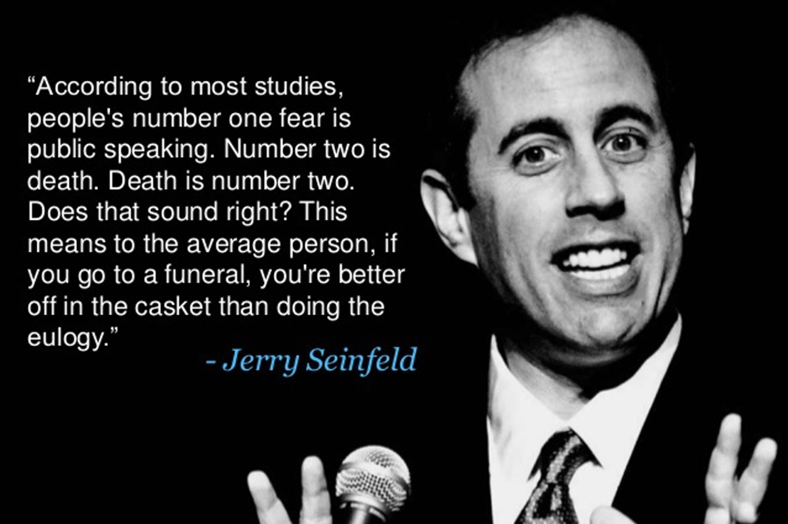
credit

Slide 3
















Just who is this guy?
Principal Data Architect, Population Health
Adjunct Instructor
Ambassador Programs
Speaker – various events
40
Years
B.S.
Computer
Science
M.S.
Computer
Information
Systems
M.S.
Health
Informatics
Doctor of Healthcare Administration

Slide 4
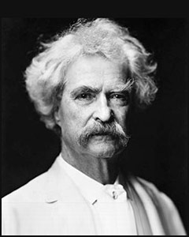
Something to consider…
credit
“There are only two types of speakers in the world: the nervous and the liars.”
-- Mark Twain (Samuel L. Clemens) 1835 - 1910

Slide 5
Me? Speak?? Are you kidding??
Why should I speak?
One of the best methods for personal growth
Helps to build extra confidence
But I don’t have anything to tell!
You have something unique to teach
You will also learn during the process
Some great benefits:
Meet really interesting people
Learn more about your topic
Learn lots more about yourself!
It’s tons of fun!!

Slide 6
How do we do this?
How to create a presentation
Select a topic
Create an abstract
Create an outline
Gather materials
Create the presentation
How to give your presentation
Prepare for the presentation
Overcome speaker anxiety
Give the presentation
Get and use feedback
Make it happen!

Slide 7
Select a Topic
Pick something useful that you can share
“I just learned something really cool!”
“I wish someone had taught me that a long time ago!”
Make sure it’s applicable to your audience
Personal experiences with the topic really help your audience relate to both you AND the topic
Don’t worry if it’s already been done
Your perspective is unique from other speakers
You will help someone who needed your viewpoint
Otherwise there would be a lot fewer presentations and speakers!

Slide 8
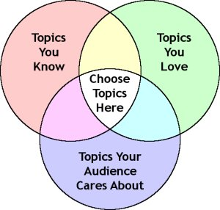
Select a Topic
Ask yourself these questions:
Do I have knowledge about this topic?
Am I passionate about this topic?
Does my audience care about this topic?
Establish goals
Want to teach a technique?
Will you solve a problem?
Plan to demonstrate a solution?
What are your objectives?
What do you expect from the audience?
credit

Slide 9
Create an Abstract
Business card of your presentation
It needs to “sell” your presentation
Event organizers – which sessions to include
Event attendees – which sessions to attend
An abstract MUST match the presentation
Faulty abstract results in unhappy attendees
If attendees are in the wrong session, it’s your fault
A clear, concise abstract improves selection and success!

Slide 10
Create an Abstract
Title
Descriptive but brief (usually a character limit)
Catchy is OK, but not too obscure
Often, quick decisions are made based on the title only
Description
Descriptive but brief (usually a word limit – 250 words or so)
Describe the issue your presentation addresses
Identify how the issue impacts an attendee
Include 2-3 key learning points for attendees

Slide 11
Create an Outline
An outline is your plan for the presentation
It ensures a logical progression from topic to topic
It keeps you focused on your goal
It helps the audience to know what to expect
A presentation with out a plan
Looses focus of the audience
Looses focus of the speaker
Wastes everyone’s time
An outline ensures your presentation will:
Cover all the points needed and only what’s needed
Keep your audience engaged
Fulfill the goal of teaching your audience

Slide 12
Create an Outline
Introduction
Opening Remarks
Purpose Summary
Preview
Topic 1
Topic 2
Topic 3
Body
Topic 1
Point 1
Point 2
Topic 2
Point 1
Point 2
Ice breaker and speaker introduction
The primary reason for the presentation
Give a preview of your main topics as an agenda
Here is the “meat” of your presentation
Go into more detail for each topic
Each topic should have at least two or more items as further detail

Slide 13
Create an Outline
Topic 3
Point 1
Point 2
Point 3
Conclusion
Review
Topic 1
Topic 2
Topic 3
Purpose Fulfilled
Closing Remarks
The items should be comprehensive enough to cover the material without getting too detailed
Review what you covered and include highlights
Show how you fulfilled your primary purpose and make a call to action
Tie everything together from beginning to end

Slide 14
Gather Materials
Select material that supports your outline
Draw upon your own knowledge & experiences
Research for gaps or missing information
Make use of reputable sources
Industry vendors and renowned industry leaders
Published works (books, magazines, etc.)
Be wary of blogs and Wikipedia
Give credit by providing source references
Quotes, paraphrases, or major contributions
Photos, images, graphics, charts, etc.

Slide 15
Create the Presentation
Abstract
Used as your “sales pitch” for your presentation
Introduces your topic and why it’s important
Identifies the goals and what the audience should get
Title Page
Establish the purpose of the presentation
Title should be short, sweet, and to the point
Sometimes catchy titles can be helpful if not obscure
Biography
Establish your credentials (experience, training, etc.)
Do not include personal information (vacation, kids, pets, religion, politics, etc.)

Slide 16
Create the Presentation
Purpose
The presentation goals (“What’s in it for me?”)
Helps to set appropriate audience expectations
Major Topics
Further refine each topic into further detail
Include supporting material as needed
Midpoint Review
Serves as a logical break when using lots of material
Used as a transition from between main portions

Slide 17
Create the Presentation
Closing
Review major topics
Include important take-aways
Provide references for further study
Present your call to action
Without this, nothing will happen
Remember: This is the whole purpose of your presentation
Questions slide
Give opportunity to ask additional questions
Provide complete contact info

Slide 18
Create the Presentation
Use simple designs
High contrast
Easy to read fonts
Minimal animation
Consistency is paramount
Slide style, transitions, fonts, animation, etc.
Delivery method and flow of slides
Sets audience expectations
Your message is the star, not your PowerPoint skills!

Slide 19
Create the Presentation
Some caution is warranted
Avoid flashy or overly dramatic animation
Too much flash will reduce the impact of your message
Be mindful of using too many colors
Lots of bright colors can be distracting
Be considerate of those who may be color blind
If colors are needed (ex. bar or pie charts)
Keep them simple with stark contrast
Label them appropriately
Simple and effective is more important

Slide 20
Demonstrations
If critical to your presentation, have backup screenshots if needed
Use test data readily accessible to anyone (ex. AdventureWorks)
NEVER use real data or work environments
Script wherever possible – typing in demos increases the chance of something going wrong
Consider using a VM, if possible, for an easy restart
Use a special Demo slide
Improve font visibility
Use a larger size (14+ point)
High contrast (dark color on light background)
Get and use ZoomIt!

Slide 21

ZoomIt
credit

Slide 22
Mid-Point Review
Here’s what we covered so far:
Selecting a topic
Creating the outline
Gathering materials
Creating the presentation
Coming up next:
Preparing for the presentation
Overcoming speaker anxiety
Giving the presentation
Getting and using feedback

Slide 23
Prepare for the Presentation
Practice, Practice, Practice!
Really practice out loud, standing in front of a mirror
Be mindful of timing and how long each portion is
Try it with an audience and record a video if possible
If you have demos
Practice many times from beginning to end
Have backup screenshots just in case
Remember Murphy’s Law: If anything can possibly go wrong, it will, and at the most inopportune time!

Slide 24
Prepare for the Presentation
Be prepared – things WILL go wrong!!
Laptop won’t start
No Wi-Fi or internet
Presentation file gets corrupted
Bad cable or adapter
Before you leave your office (in person)
Multiple backups of slides, scripts, demos, etc.
Pack every cable & adapter needed; include extras
Include extra batteries for your remote & mouse
Don’t forget business cards!

Slide 25
Prepare for the Presentation
Before your presentation (virtual)
Have slide deck and demos primed and ready
Connect to the presentation session early
Perform headset check
Check in with the session moderator/assistant
Self-promote your presentation!
LinkedIn – include event and location info
Twitter – use special hashtags where applicable
Personal Blog – a good place for the abstract as well

Slide 26

Overcome Speaker Anxiety
credit

Slide 27

Overcome Speaker Anxiety
Glossophobia
Come from fear of being judged
No one gives a perfect speech
Ralph Waldo Emerson: “All the great
speakers were bad speakers at first.”
Face your fears
Don’t focus on real or imagined mistakes
Don’t worry that your audience will be critical
Preparation is key, but it’s OK not to be perfect
credit

Slide 28
Overcome Speaker Anxiety
Know your material, slides, and demos
Practice, practice, practice!
“Surprises” increase stress
Anticipate questions and have answers ready
Be willing to say “I don’t know”
Go easy on yourself! We are often our worst critics.
Relax!
Go to the bathroom 20 minutes before your presentation
Stretch and walk around to relieve tension
Most important: Breathe! You’re going to need your brain, and it needs oxygen!

Slide 29
Overcome Speaker Anxiety
Work with your audience (live)
Talk to people – helps you to relate to your audience
Don’t focus too much on individual expressions
Interact with the audience as much as possible
None of us are professional speakers
Remember: You are NOT on trial to be judged!!
You are NOT the focus – your subject matter is
We all have empathy for speakers who are trying
Your audience will have the same empathy for you!
With practice and repetition, speaker anxiety will diminish but may never completely go away

Slide 30
Before Your Presentation
Set up ahead of time and check everything out
Shut down distractions (email, IM, phone, etc.)
Queue up your presentation and get demos ready
“Customize” your area, even if a little
Make sure you have extra water bottles
Enlist someone to help (live)
Pass around any handouts (not usually suggested)
Give a 15-minute and 5-minute warning
It’s OK to chat with folks before the presentation to help everyone (including you) relax!

Slide 31
Give Your Presentation! (Live)
Step away from the podium or laptop
Make use of a presentation device
Move around to keep both you and your audience engaged
Repeat questions asked
Not all may hear it initially
Helps to ensure that you understand the question yourself
Time permitting, before answering, give the question to the audience to answer

Slide 32
Give Your Presentation! (Virtual)
Remember that you do have an audience
Keep your focus on the camera
Speak clearly and don’t get rushed
Don’t get “robotic” – remember that you do have an audience
Make use of the chat feature
A moderator can help with questions
Periodically stop to answer questions just as with a live audience
If possible, allow the audience to participate

Slide 33
Give Your Presentation!
Be flexible
Be ready to focus on certain slides as needed
Be ready to skip slides to adjust for time
Have fun!!
Your audience will enjoy it as well
You will grow from the experience
Things to Avoid
Don’t read your slides!!
Hot Topics: Politics & Religion
Be Prudent: Gender or racial bias
Be Sensible: Profanity, inside jokes

Slide 34
Answering Questions
Set guidelines about questions
Set a time limit on questions and keep to it
Make the answers succinct to answer as many as possible
Don’t’ be afraid to say, “I don’t know, but I’ll find out and let you know.”
Paraphrase the question rather than merely repeat it
It ensures the audience that you understand the question
You can typically shorten it to the essential question
Listen carefully to the entire question
Don’t interrupt even if you know what the question will be
Maintain eye contact to show you’re focused on the question
Address your response to the entire room

Slide 35
Get Feedback
On subject, presentation skills, etc.
In person at end of your presentation
Session Evaluations
Written or electronic, formal or informal
Throw out extremes – focus on the most common
Winston Churchill: “Criticism may not be aggregable, but it is necessary. It fulfills the same function as pain in the human body. It calls attention to an unhealthy state of things.”

Slide 36
Use Feedback
Constructive criticism should always be welcome
Hillary Clinton: “Take criticism seriously, but not personally. If there is truth or merit in the criticism, try to learn from it. Otherwise, let it roll right off you.”
Criteria for effective feedback:
Credible, Trusted, Instructive, Appropriate, Interactive, Clear, Helpful
Learn what to ignore and what to consider
Don’t let compliments go to your head
Don’t let criticism get to your heart

Slide 37
Closing Thoughts
Pulling it together
Select a topic – That’s appropriate and helpful
Create an outline – The plan for your presentation
Gather materials – To support your presentation
Create the presentation – To deliver your topic
Putting it on
Prepare for the presentation – To avoid surprises
Overcome speaker anxiety – To relieve stress
Give the presentation – The whole purpose!
Get and use feedback – To improve for the next time

Slide 38
Make it Happen!
Where to speak?
Local/Virtual User Group or Conference
National/International Conference (many are virtual)
Many other venue choices
Jot down notes
Presentation ideas, main points or an abstract
Create an outline and flesh it out over time
Practice creating your presentations
Ask for feedback before you present
Set a date and just do it!!

Slide 39
Helpful Resources
The Secret of Choosing Successful Speech Topics
The Complete Guide To Creating A Captivating Professional Presentation
Presentation Zen Design: Simple Design Principles and Techniques to Enhance Your Presentations (2nd Edition)
How to Overcome the Fear of Public Speaking in 5 Minutes
How to Give and Receive Feedback at Work: The Psychology of Criticism

Slide 40
Thanks to our Sponsors!
Without them, we wouldn’t be here!!

Slide 41






Questions & Comments
BONUS:
A TON of free eBooks from RedGate and others!
PRESENTATION FEEDBACK:
Your thoughts needed
Improve presentations
Make this event even more valuable!!!
Aaron N. Cutshall
www.linkedin.com/in/sqlrv
aaron@sqlrv.com
www.sqlrv.com
www.youtube.com/@sqlrv

